Slide 1

MAULANA AZAD
NATIONAL INSTITUTE OF TECHNOLOGY
BHOPAL INDIA, 462003
DEPARTMENT OF COMPUTER SCIENCE & ENGINEERING
Brain Tumor Detection and Classification :
Machine Learning vs Deep Learning
Submitted By:
KOMAL BISHT | 191112437
BHUMIKA GUPTA | 191112435
TANISHQ YADAV | 191112417
AMAN RAHANGDALE | 191112405
Under the Guidance of
PROF. JAYTRILOK CHOUDHARY

Slide 2
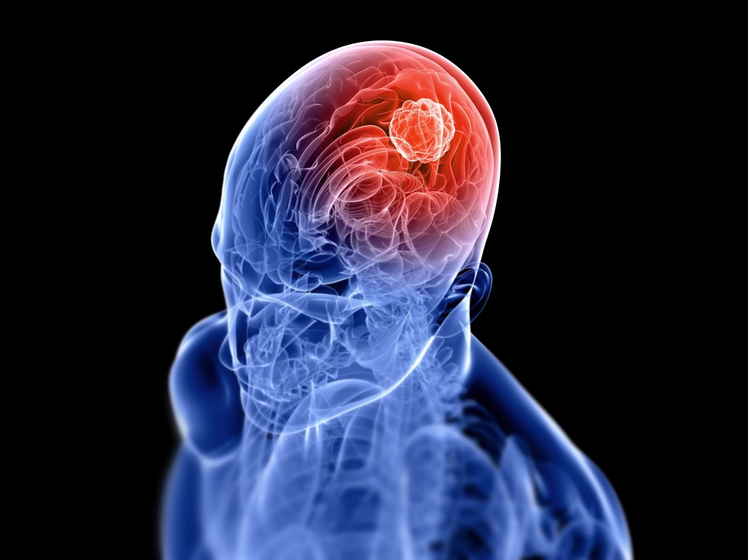
ABSTRACT
Brain Tumors are complex .Often times in developing countries the lack of skillful doctors and lack of knowledge about tumors makes it really challenging and time-consuming to generate decisions from MRIs.
Thus automation of this diagnostic process using deep learning would be helpful.
Our proposed automation system using deep learning would take an MRI and analyze it to find Benign (Non-Cancerous) and Malignant (Cancerous) Tumors
By training and evaluating the CNN on a dataset of brain MRI images and corresponding tumor labels, we aim to demonstrate the potential of using deep learning techniques for brain tumor classification in MRI scans

Slide 3
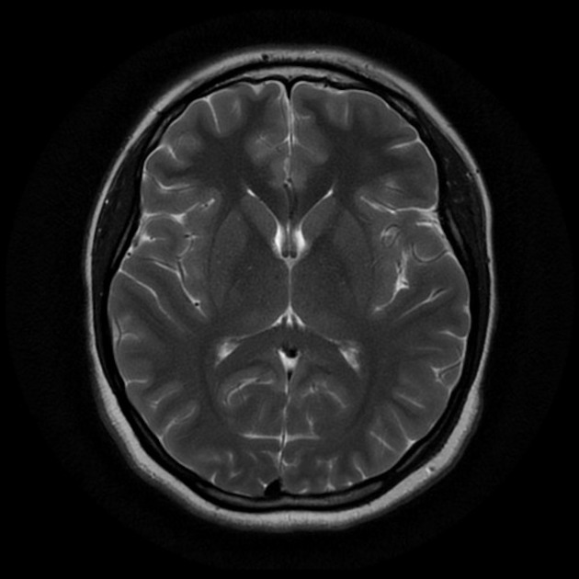
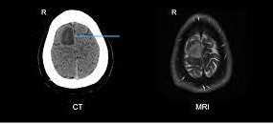
Figure: MRI and CT Scan

Slide 4
LITERATURE SURVEY
"Deep learning-based brain tumor classification using transfer learning and data augmentation," by J. Park et al. (2020) [6] This paper presents a deep learning-based approach for brain tumor classification using transfer learning with the EfficientNet architecture and data augmentation. The authors compare the performance of their approach with other state-of-the-art methods and show that it achieves improved accuracy and robustness.
"Automated brain tumor classification using a convolutional neural network and TensorFlow," by R. Kavuru et al. (2019)[7] This paper describes the development of a CNN-based approach for automated brain tumor classification using TensorFlow. The authors evaluate the performance of their model on a dataset of brain MRI scans and demonstrate its effectiveness in accurately classifying different types of brain tumors.
"Transfer learning for brain tumor classification using convolutional neural networks," by M. K. Singh et al. (2018)[8] This paper investigates the use of transfer learning for brain tumor classification using CNNs. The authors compare the performance of several popular CNN architectures, including VGG-16 and ResNet, and show that transfer learning can significantly improve the accuracy of the classifier.
"Brain tumor classification using convolutional neural networks and transfer learning," by R. Tiwari et al. (2017)[9] This paper presents a CNN-based approach for brain tumor classification using transfer learning with the VGG-16 architecture. The authors evaluate the performance of their model on a dataset of brain MRI scans and demonstrate its effectiveness in classifying different types of brain tumors.
"Deep learning versus machine learning for brain tumor classification using magnetic resonance imaging: a comparative study" (Zhou et al., 2018)[10] - This paper compares the performance of several deep learning and machine learning algorithms for classifying brain tumors using magnetic resonance imaging (MRI) data. The authors found that deep learning methods outperformed traditional machine learning methods in terms of accuracy and sensitivity.
"Deep learning versus machine learning for glioma grading using magnetic resonance imaging: a comparative study" (Cao et al., 2019)[11] This paper compares the performance of deep learning and machine learning algorithms for grading gliomas, a type of brain tumor, using MRI data. The authors found that deep learning methods outperformed traditional machine learning methods in terms of accuracy and sensitivity.

Slide 5
PREVIOUSLY USED ML APPROACH
( USING RANDOM FOREST )

Slide 6
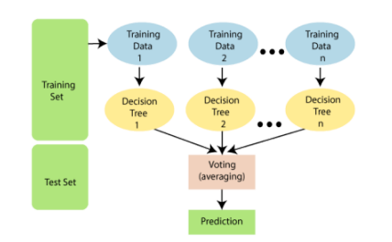
METHOD
Data preprocessing:
Median filter to remove noise and smooth the image
Segmentation to identify and isolate the tumor region in the image
Edge detection to enhance the boundaries of the tumor
Grey co-occurrence matrix to extract texture features from the image
Tumor classification using random forest:
Train a random forest model on a dataset of brain tumor images labeled as benign or malignant
Use the trained model to make predictions on new, unseen brain tumor images
Evaluate the performance of the model using metrics such as accuracy, precision, and recall.

Slide 7
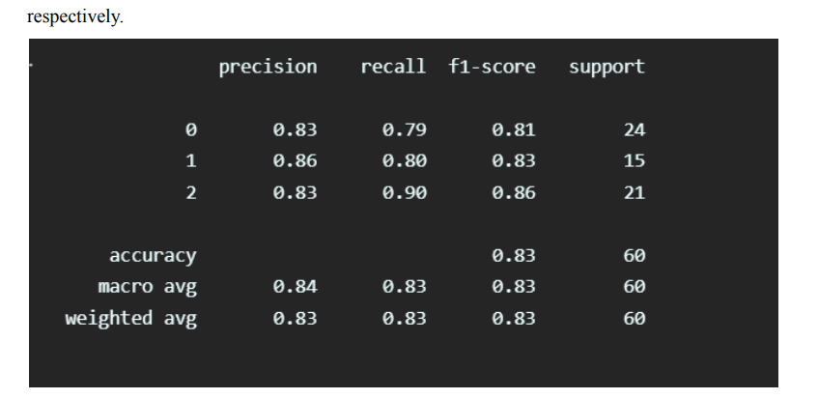
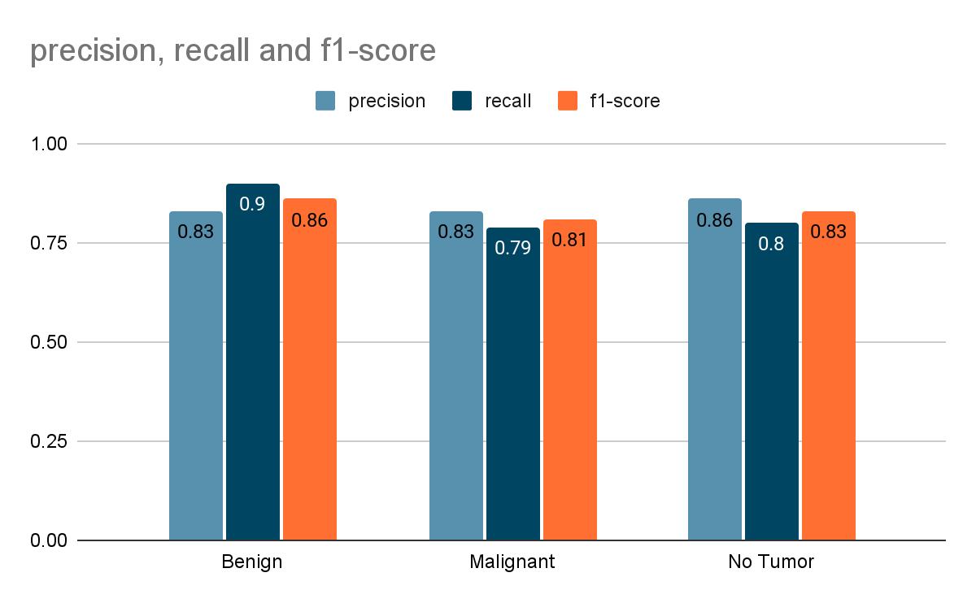
Performance of Random forest
Overall Accuracy achieved was 83.33%

Slide 8
Drawbacks of brain tumor classification
using the machine learning approach
Limited training data: Machine learning models may struggle with small or unbalanced datasets. CNNs and transfer learning can help to mitigate this issue.
Spatial relationships: Machine learning models may not effectively capture complex spatial relationships in medical images. CNNs are well-suited for handling such relationships.
Generalizability: Machine learning models may not generalize well to different datasets or imaging modalities. CNNs trained on large and diverse datasets can improve generalizability.
Validation and testing: Deep learning models, including CNNs, should be thoroughly validated and tested to ensure they are robust and generalize well to new data.

Slide 9
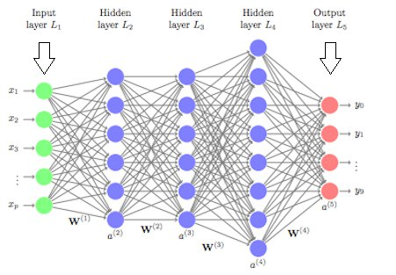
Why Convolutional Neural Network ?
Because of these large number of connections the number of parameters to be learned increases. This more complexity of the network leads to overfitting. Especially, in the case of Image data being pixel values of the images as features, the number of input features would be of large dimension.
To overcome these challenges, the Convolution Neural Networks were discovered. In this, the input image data will be subjected to set of convolution operations. The resultant data which will be of lesser dimension compared to the original image data will be subjected to Fully connected layers to predict . By performing the convolution operations, the dimensionality of the data shrinks significantly large. Hence, the number of parameters to be learned decreases. Hence, the network complexity decreases which leads to less chances of overfitting!

Slide 10
SYSTEM STRUCTURE
MRI SCAN
Collect data
Model Training
Model Evaluation
Data Preprocessing
CNN/Transfer learning
BENIGN
MALIGNANT
MENINGIOMA
GLIOMA
PITUITARY

Slide 11
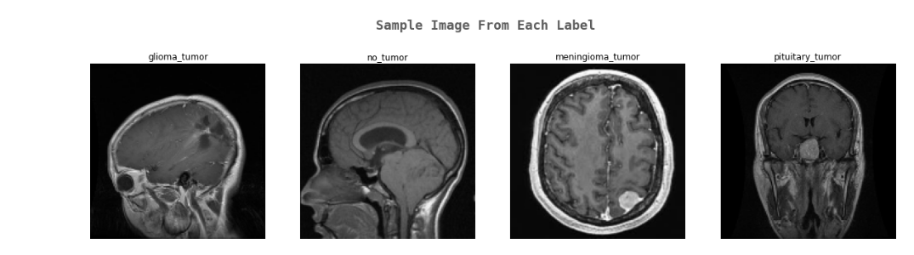
Data Collection and Preparation:
The first step in this project will be to collect a dataset of brain MRI images with and without tumors
The collected data will then be preprocessed and labeled into four categories: glioma, meningioma, pituitary, and no tumor. The data will then be split into a training set and a testing set.
Training set : glioma - 826, meningioma - 822, pituitary - 827, no tumor - 395
Testing set : glioma - 100, meningioma - 115, pituitary - 74, no tumor - 105

Slide 12
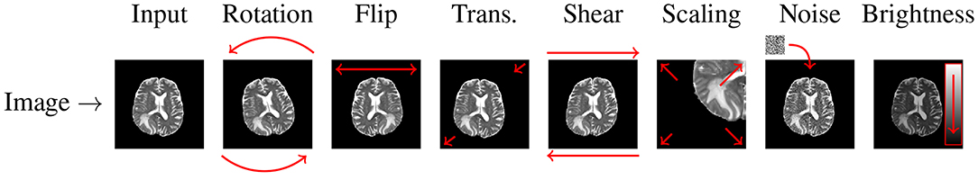
Image Pre-Processing
What is pre-processing and why to do it? To make the data suitable for training the CNN model.
Pre-Processing involves processes like
normalizing the pixel values
resizing the images to a consistent size
applying data augmentation techniques to increase the size of the dataset such as random cropping, rotation, and horizontal flipping

Slide 13
THE DEEP LEARNING APPROACH
( USING CNN)

Slide 14
We have proposed and used a newly designed CNN architecture. The architecture consists of following layers to enable the classifier to grade the brain tumor effectively.
Sequential
Batch Normalization
Convolutional : Relu Activation
Dropout
Max pooling
Dense
Batch Normalization
Batch Normalization
Convolutional : Relu Activation
Dropout
Max pooling
Dense: Softmax
Batch Normalization
Flatten
Dense

Slide 15
Layers used in CNN architecture:
i) The convolutional layer
The convolutional layer is the key component of convolutional neural networks, and is always at least their first layer. Its purpose is to detect the presence of a set of features in the images received as input.
ii) The pooling layer
This type of layer is often placed between two layers of convolution. It receives several feature maps and applies the pooling operation to each of them.
iii) Dropout Layer
Usually, when all the features are connected to the FC layer, it can cause overfitting in the training dataset. To overcome this problem, a dropout layer is utilised wherein a few neurons are dropped from the neural network during training process resulting in reduced size of the model.
iv) Dense layer is a fully connected layer in a neural network, which means that each neuron in the layer is connected to every neuron in the previous layer
v) Batch Normalization layer
Layer that normalizes its inputs. Batch normalization is a technique for training very deep neural networks that standardizes the inputs to a layer for each mini-batch.
vi) Flatten is used to flatten the input. Flattening a tensor means to remove all of the dimensions except for one.

Slide 16
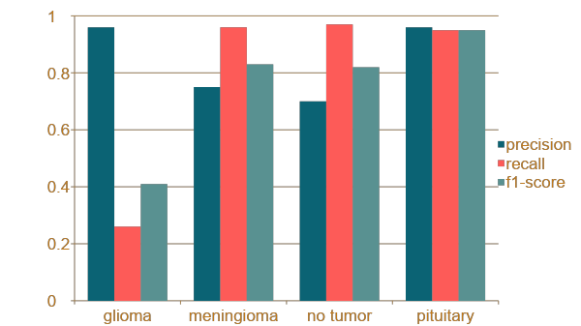
Performance of CNN
Overall accuracy achieved is around 80%
Performance of Random forest

Slide 17
THE DEEP LEARNING APPROACH
( USING EFFNET B0)

Slide 18
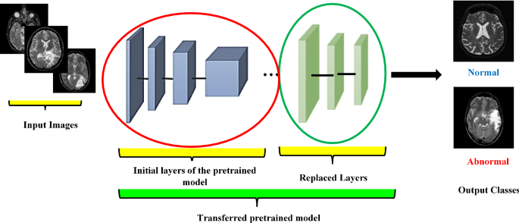
Why Transfer Learning?
Use transfer learning to fine-tune EfficientNet-B0 on the ImageNet dataset for brain tumor classification using a CNN
EfficientNet-B0 is a high-performing, pre-trained model that has already learned useful features and patterns for image classification
Fine-tuning a pre-trained model is faster and requires fewer resources than training a model from scratch
Transfer learning can improve model performance on the new task by leveraging knowledge from the original task
Using a pre-trained model can provide a good baseline for comparison when evaluating the performance of a CNN for brain tumor classification.

Slide 19
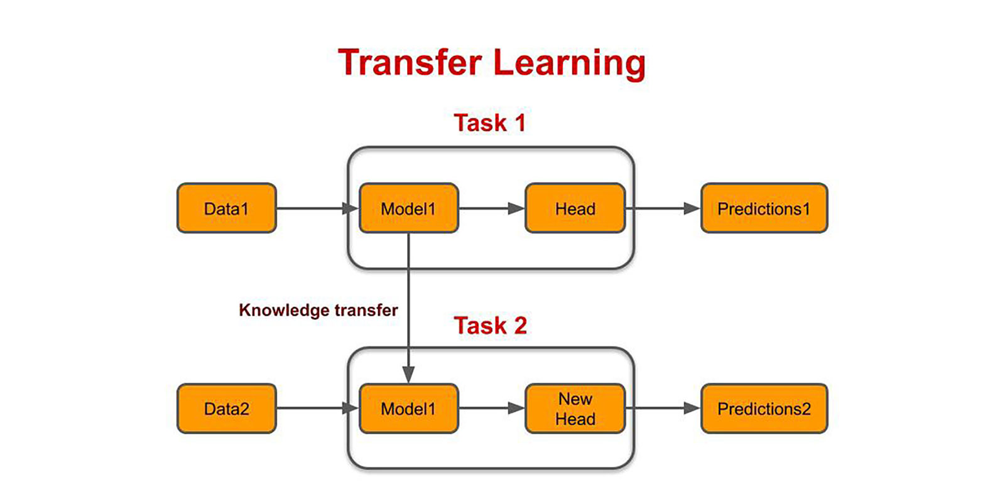
Transfer Learning
Transfer learning is a technique in which a pre-trained model, that has already been trained on a large dataset, is fine-tuned on a new task with a smaller dataset.
Used EfficientNetB0 model which was trained on the ImageNet dataset
The model will include a GlobalAveragePooling2D layer, a Dropout layer, and a Dense layer.
GlobalAveragePooling2D layer takes the average of all the feature maps in the input and reduces the spatial dimensions of the input to a single value.
The Dropout layer is a regularization technique that is often used in deep learning models to prevent overfitting.
The Dense layers are used at the end of a CNN to map the features extracted by the convolutional and pooling layers to the final output classes.

Slide 20
Model Training
Model will be trained on the training dataset using an appropriate optimization algorithm
Callbacks such as TensorBoard, ModelCheckpoint, and ReduceLROnPlateau can be used to monitor the training process and improve the performance of the model.
TensorBoard is a tool provided with TensorFlow that allows users to visualize the training process and the performance of a model.
ModelCheckpoint is a callback in TensorFlow that can be used to save the weights of a model at regular intervals during training.
ReduceLROnPlateau class reduces learning rate when a metric has stopped improving

Slide 21
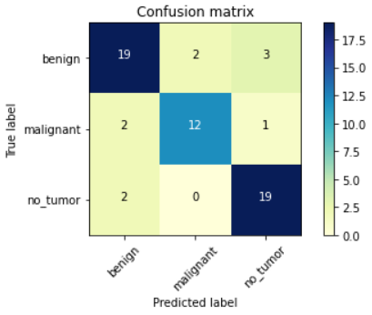
Model Evaluation
Once the model has been trained, it will be evaluated on the test dataset to assess its performance in detecting brain tumors. A confusion matrix will be generated to visualize the model's performance for each of the four categories. The model's performance will also be compared to the results obtained from a machine learning model for brain tumor detection.

Slide 22
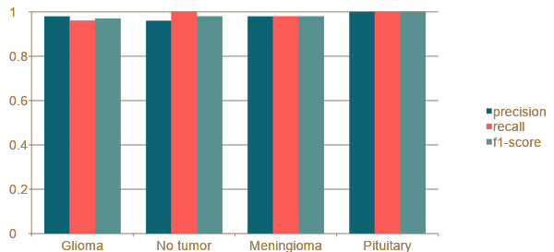
Performance of EffnetB0
Overall accuracy achieved is 98%

Slide 23
Let’s look at the Demo

Slide 24
Future scope
One possible avenue for future work is to expand the dataset used in this project to include a larger variety of brain tumor types and also to include images from different medical centers.
One area for improvement could be to explore the use of other CNN architectures, such as ResNet or DenseNet, and compare their performance with the EfficientNetB0 model .
Improve testing accuracy and computation time by using classifier boosting techniques like fine-tuning hyper parameters, training for a longer time i.e. using more epochs, adding more appropriate layers etc..
Classifier boosting can be used.
Unsupervised transfer learning may attract more and more attention in the future.

Slide 25
REFERENCES
J. Park, et al., "Deep learning-based brain tumor classification using transfer learning and data augmentation," 2020.
R. Kavuru, et al., "Automated brain tumor classification using a convolutional neural network and TensorFlow," 2019.
M. K. Singh, et al., "Transfer learning for brain tumor classification using convolutional neural networks," 2018.
R. Tiwari, et al., "Brain tumor classification using convolutional neural networks and transfer learning," 2017.
Zhou, et al., "Deep learning versus machine learning for brain tumor classification using magnetic resonance imaging: a comparative study," 2018.
Cao, et al., "Deep learning versus machine learning for glioma grading using magnetic resonance imaging: a comparative study," 2019.

Slide 26


